Slide 1
ANTI - EPILEPTIC DRUGS
DR.ASHISH RANJAN
DEPT. OF PHARMACOLOGY
S.K.M.C,MUZAFFARPUR .

Slide 2
SEIZURE : It is an abnormal eletrical discharge produced by abnormal focus in brain.
CONVULSION : it is motor menifestation of electrical discharge.
EPILEPSY : Repetitive episodes of seizure.

Slide 3
Major types of epilepsy are described below
Generalised seizure
1. Generalised tonic-clonic seizure
2. Absence seizure
3. Atonic seizure
4. Myoclonic seizure
5. Infantile spasm
II. Partial seizure/ focal seizure
Simple partial seizure
Complex partial seizure
3. Simple partial or complex partial seizures secondarily
generalized.

Slide 4
Mechanisms by which we may treat epilepsy
Na+ channel blocking.
Ca+ channel blocking.
K+ channel Opener.
Increased GABA activity.
Decreased Glutamate activity.

Slide 5
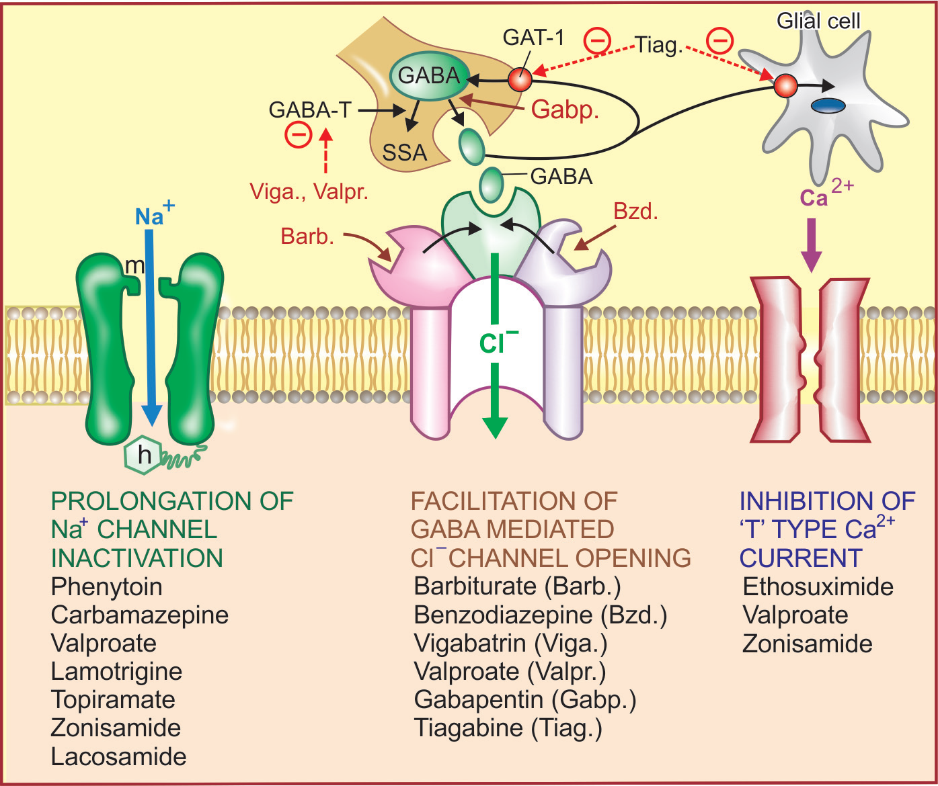

Slide 6
Phenytoin
Mode of action :
Phenytoin has a neuronal membrane stabilizing effect. This is achieved by prolonging the inactivated state of voltage sensitive neuronal Na+ channel that governs the refractory period of the neurone. As a result high frequency discharges are inhibited with little effect on normal low frequency discharges which allow Na+ channels to recover even when their inactivation is prolonged.
Intracellular accumulation of Na+ that occurs during repetitive firing is prevented. Therapeutic concentrations have no effect on resting membrane potential. normal synaptic transmission is not impaired.

Slide 7
Pharmacokinetics
Absorption of phenytoin by oral route is slow. Bioavailability of different market preparations may differ. Phenytoin is metabolized in liver by hydroxylation involving CYP2C9 and CYP2C19. The kinetics of metabolism is changes from first order to zero order over the therapeutic range. As a result small increments in dose produce disproportionately high plasma concentrations.
USES : Generalized tonic-clonic seizure
Simple and complex partial seizure.
Status Epileticus.
Trigeminal Neuralgia

Slide 8
Adverse effects
Gum hypertrophy
Hirsutism, coarsening of facial features, acne
3. Megaloblastic anaemia: Phenytoin decreases folate absorption and increases its excretion.
4. Osteomalacia
foetal hydantoin syndrome : hypoplastic phalanges, cleft palate, hare lip, microcephaly.
6.Hypersensitivity reactions are : rashes, lymphadenopathy.
7. Hyperglycemia by inhibiting insulin release.
8. Cerebellar and vestibular manifestations: ataxia, vertigo
diplopia, nystagmus are the most characteristic features.
9. Drowsiness, behavioral alterations, mental confusion
hallucinations, disorientation.
10 .Fall in BP and cardiac arrhythmias occur only on i.v. injection

Slide 9
VALPROATE
MODE OF ACTION : Valproate acts by multiple mechanisms:
(i) A phenytoin-like frequency-dependent prolongation of Na+ channel inactivation.
(ii)Weak attenuation of Ca2+ mediated ‘T’ current.
(iii) Augmentation of release of inhibitory transmitter GABA by inhibiting its degradation by GABA-transaminase.
USES : Generalised tonic clonic seizure
Absence seizure
Myoclonic seizure
Atonic seizure
Also used in BIPOLAR DISORDER.

Slide 10
ADVERSE EFFECTS : Vomiting
Alopecia/ curling of hair
hepatotoxic
Pancreatitis
Polycystic ovarian disease
obesity
cerebellar symptoms like ataxia, nystagmus

Slide 11
Carbamazepine
It blocks the Na channel by prolonging the inactivated state of Na channel.
USES : FOCAL SEIZURE
TRIGEMINAL NEURALGIA.
DIABETES INSIPIDUS.
BIPOLAR DISORDER.
ADVERSE EFFECT : Aplastic anemia
Increased ADH leading to SIADH & dilutional
Hyponatremia .
Ataxia, nystagmus,vertigo .

Slide 12
TOPIRAMATE
It acts by multiple mechanisms
1. Prolongation of Na+ channel inactivation
2. GABA potentiation by post synyptic effect
3. Glutamate receptors antagonist
4. Weak carbonic anhydrase inhibitor
USES :
Generalised tonic clonic seizure
Simple and complex partial seizure
Prophylaxis of migraine
Obesity
ADVERSE EFFECTS : Renal stone
word finding difficulties
ataxia

Slide 13
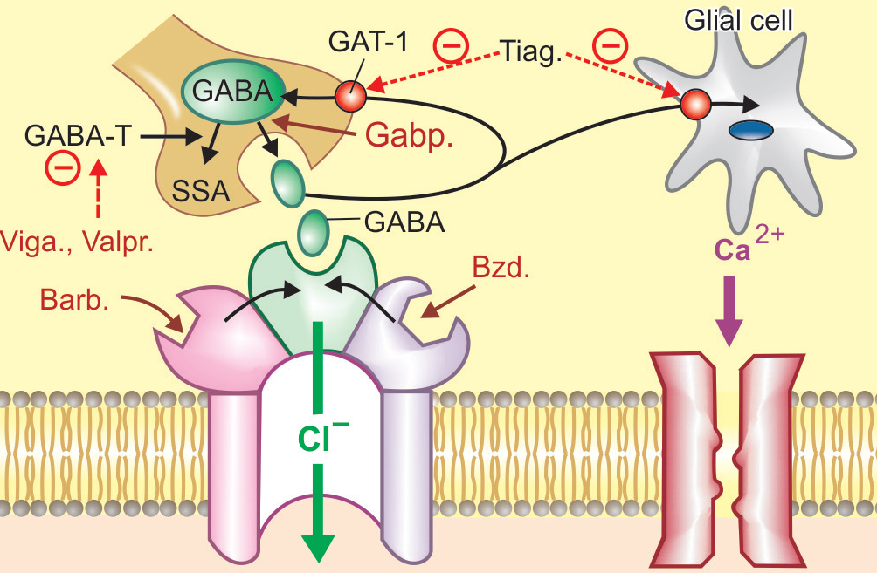
DRUGS ACTING ON GABA

Slide 14
1.) Increased release of GABA : PREGABALIN
GABAPENTIN
USES Epilepsy
Neuropthic pain : Diabetic neuropathy, Post herpetic pain.
2.) GABA Transaminase Inhibitor : VIGABATRIN
USE : Infantile Spasm
Advesrse effect : Visual field defect
3.) GABA Transporter GAT-1 Inhibitor : TIAGABIN
4.) Directly acting on Cl Channel : Barbiturate ( PHENOBARBITONE)
Benzodiazepines
DIAZEPAM : used in FEBRILE SEIZURE
LORAZEPAM : used in STATUS EPILEPTICUS
CLONAZEPAM : used in ABSENCE SEIZURE
CLOBAZAM : used in LENNOX GESTAUT SYNDROME.

Slide 15
DRUGS ACTING ON DECREASED ACTIVITY OF GLUTAMATE
1.) NMDA (N-methyl D-aspartate) receptor blocker : FELBAMATE
2. ) AMPA(α amino 3 hydroxy 5 methyl 4 isoxazole propionic acid ) receptor blocker :
PERAMPANEL used in FOCAL SEIZURE.
T- type Ca Channel blocker : ETHOSUXIMEDE
The primary action exerted on thalamocortical system which is involved in the generation of absence seizures. Thalamic neurones exhibit prominent ‘T’(transient) current. Ethosuximide is used only in FOCAL SEIZURE.

Slide 16
OTHER DRUGS : 1 ) LEVETIRACETAM / BRIVACETAM
It modify synaptic release of glutamate/GABA by binding to a specific synaptic protein labelled SV2A .
2) Lamotrigine : Acts by
Prolongation of Na+ channel inactivation and
Preventing release of excitatory neurotransmitters, mainly
glutamate and aspartate.
Adverse effect : Stevens-Johnson Syndrome
Toxic Epidermal Necrolysis
3) CANNABIDIOL & STERIPENTOL : Used in
DRAVET SYNDROME.
4.) K+ channel opener : RETIGABINE used in
FOCAL SEIZURE

Slide 17
Status epilepticus :
When seizure activity occurs for >30 min, OR two or more seizures occur without recovery of consciousness, the condition is called status epilepticus. seizures have to be controlled as quickly as possible to prevent death and permanent brain damage.
TREATMENT : 1. Lorazepam is the drug of choice. 4 mg injected i.v. repeate once after 10 min if required.
2. Diazepam 10 mg injected i.v. repeate once after 10 min if required.
3. Fosphenytoin 100–150 mg/min i.v. infusion
4. Phenytoin sod.
5. Phenobarbitone sod. 50–100 mg/min i.v.

Slide 18
6. Refractory cases who fail to respond to lorazepam and fosphenytoin within 40 min of seizure onset may be treated with i.v. midazolam/propofol/thiopentone anaesthesia.

Slide 19
Febrile convulsion :
Children under 5 years age develop convulsions during fever. Seizures may recur every time with fever and few may become chronic epileptics.
Treatment : 1. Paracetamol and external cooling
2.Rectal diazepam 0.5 mg/kg is main treatment
In recurrent cases : Intermittent prophylaxis with diazepam (oral or rectal) started at the onset of fever.

Slide 20
THANK YOU

